Slide 1
A Presentation on Cloud Computing

Slide 2
What is Cloud Computing ?
‘Cloud’ refers to servers that are assessed over the internet and all the software and databases that run on those servers.
Cloud computing is a general term that involves delivering and accessing hosted service over the internet.
Cloud computing is the practice of using the network of remote servers hosted on the internet to store, manage and process the data.
Cloud computing is the combination of hardware and software based computing resources delivered as a network service.

Slide 3
Service Models
They are the reference models on which the cloud computing is based. Service models can be categorized into three basic models. They are :
1. Infrastructure as a service (IaaS)
It provides access to fundamental resources such as physical machines, virtual machines, virtual storage etc. eg: OpSource, GO GRID etc.
2. Platform as a service (PaaS)
It provides runtime environment for applications, development and deployment tools etc. It provides facilities required to support the complete life cycle of building and delivering web applications and services entirely from the internet. eg: Amazon web services, salesforce etc.
3. Software as a service (SaaS)
This model allows to use software applications as a service to end users. Eg: NETSUITE, postini etc.

Slide 4
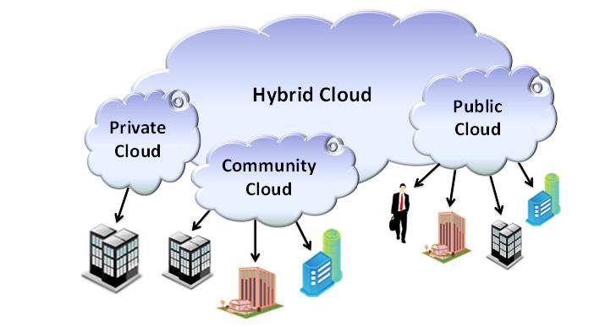
Deployment Models
Deployment models define the type of access to the cloud, i.e., how the cloud is located? Cloud can have any of the four types of access: Public, Private, Hybrid and Community.

Slide 5
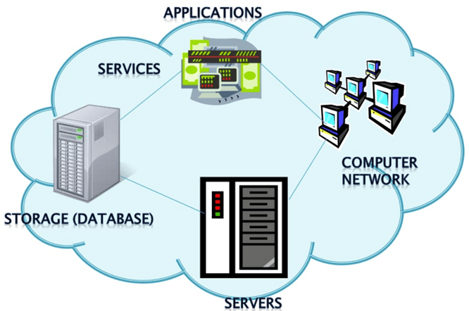
Advantages of cloud computing Here, are important benefits for using Cloud computing in any organization:

Slide 6
Cost Savings
Cost saving is the biggest benefit of cloud computing. It helps you to save capital cost as it does not need any physical hardware cost. The buying and managing of equipment is done by the cloud service provider.
Competitive edge
Cloud computing offers a competitive edge over your competitors. It helps you to access the applications any time without spending your time and money on installations.
High Speed
Cloud computing allows you to deploy your service quickly in fewer clicks. This faster deployment allows you to get the resources required for your system within fewer minutes.

Slide 7
Back-up and restore data
Once the data is stored in a Cloud, it is easier to get the back-up and recovery of that, which is otherwise very time taking process on-premise.
Mobility & Reliability
Reliability is one of the biggest pluses of cloud computing. You can always get instantly updated about the changes.
Unlimited storage capacity
The cloud offers almost limitless storage capacity. At any time you can quickly expand your storage capacity with very nominal monthly fees.

Slide 8
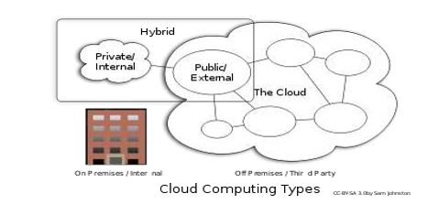
Types of Cloud Computing:
Public cloud
Private cloud
Hybrid cloud

Slide 9
PUBLIC CLOUD : The Public Cloud allows systems and services to be easily accessible to the general public. Public cloud may be less secure because of its openness, e.g., e-mail.

Slide 10
PRIVATE CLOUD : The Private Cloud allows systems and services to be accessible within an organization. It offers increased security because of its private nature.

Slide 11
HYBRID CLOUD : The Hybrid Cloud is mixture of public and private cloud. However, the critical activities are performed using private cloud while the non-critical activities are performed using public cloud.

